Slide 1
Generative adversarial network (GAN)
Liu jinyu
Notes:
Today I’m going to talk about Generative adversarial network proposed in 2014 and it’s big progress in these years.

Slide 2
Generative adversarial network
The birth of GANs
LAPGANs - The application of Laplacian Pyramid
Using GANs to transform text to image
Using GANs to generate super resolution image
P1
Notes:
Now AI already lets machines do a lot of things. But we have a prospection that
People can interact with machines in a more natural way.
To help with the improvement of machines, the generative adversarial network was brought out by Ian Goodfellow in 2014 that two artificial neural networks containing a generator and a discriminator update each other through a combating game inspired by zero-sum game.

Slide 3
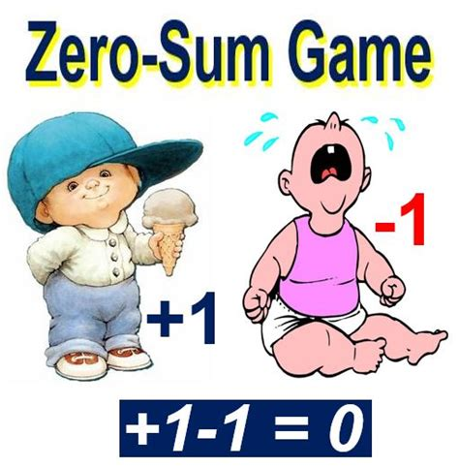
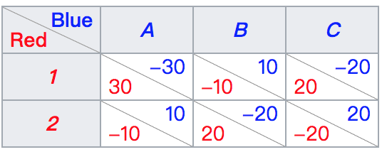
The birth of GANs
P2
Notes:
So what is zero-sum game
It’s a mathematical representation of a situation where the total gains balance the total losses of all the participates. Just like, cutting a cake, where taking a larger piece reduces the amount of cake available for others. And the cake cannot be enlarged anyhow.

Slide 4
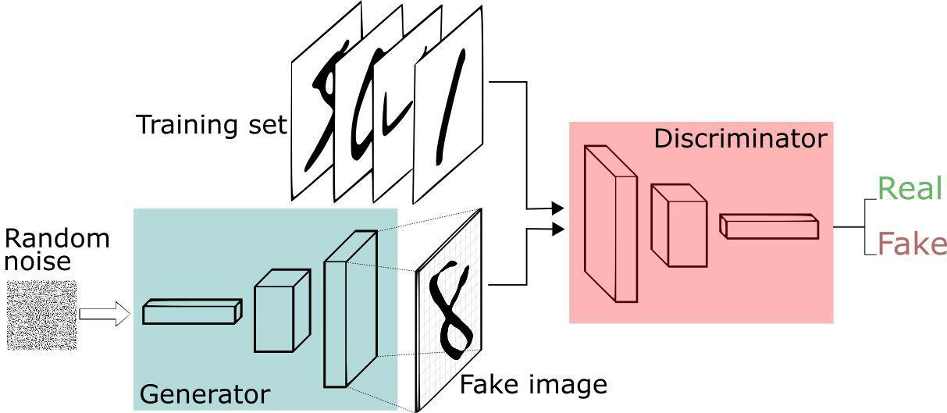
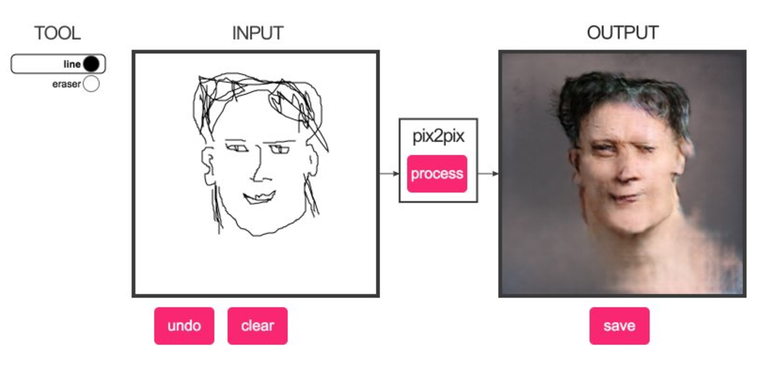
The birth of GANs
GAN
P3
Notes:
Go back to GAN.
the “generator” network creates images based on random data. And Researchers train the second “discriminator” network through machine learning to be able to tell the difference between a real image and a data file of shapes and colors. The discriminator then analyzes a series of files, some from a database of real images and others created by the generator network.
At the beginning, the generator is not very good at creating realistic images and the discriminator easily flags them as fakes.
Eventually, the generator is supposed to learn from the discriminator’s responses and (click) begin to produce increasingly more realistic images.

Slide 5
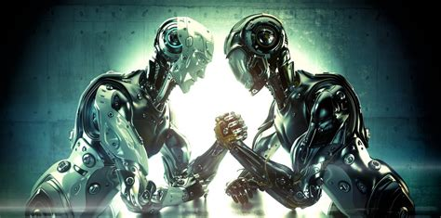
The birth of GANs
P4
Notes:
In this way the generator and discriminator are adversaries, with the former trying to fool the latter and the latter trying to avoid being fooled.
It also comes concerns in the beginning that GANs are not stable, and it might never get start to learn or generate what we want. But in the last few years, some progresses have already made.

Slide 6
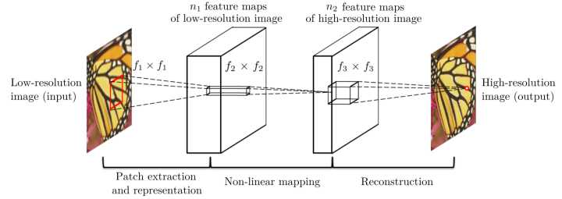
LAPGANs - The application of Laplacian Pyramid
Convolutional neural networks
P5
Notes:
The first I’m going to introduce is the application of Laplacian pyramid.
One of the most important appilication of GAN is to generate photographs that look at least real to human observers, with many realistic characteristics, which require a large amount of training.
It is known that CNN(Convolutional neural networks) can be used to increase the resolution of pictures.
In 2014, researchers stated that using a series of network based on CNN framwork to produce pictures can produce much higher resolution.

Slide 7
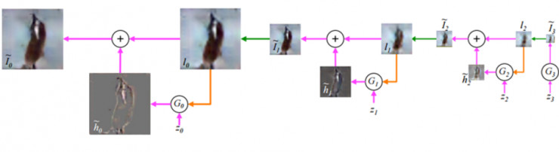
LAPGANs - The application of Laplacian Pyramid
LAPGANs
P6
Notes:
In other word, every layer of the pyramid will produce a higher resolution outcome which will be used as the input of next layer.
And this application makes the learning process of GAN sequential, which means completing the learning process step by step instead of in one time.
The second progress is about

Slide 8
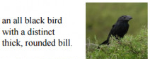
Using GANs to transform text to image
TWO STEPS
1. using natural language process to understand the content
2. using generator net to present the meaning by a natural image
TEXT —> IMAGE
P7
Notes:
using GANs to transform text to image
this task including 2 main parts.
1. using natural language process to understand the content
2. using generator net to present the meaning by a natural image
which means the discriminator has to make sure that “fake” or unnatural images are rejected as well as images that mismatch the text.

Slide 9
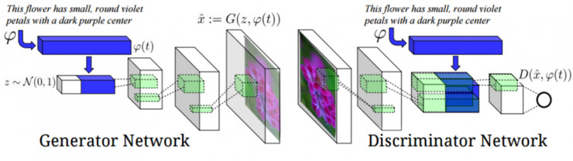
Using GANs to transform text to image
Text encoder
P8
Notes:
To achieve these goals, both of the generator and discriminator are equipped with text encoder which can create text attributes as conditions of the training process of GAN.

Slide 10
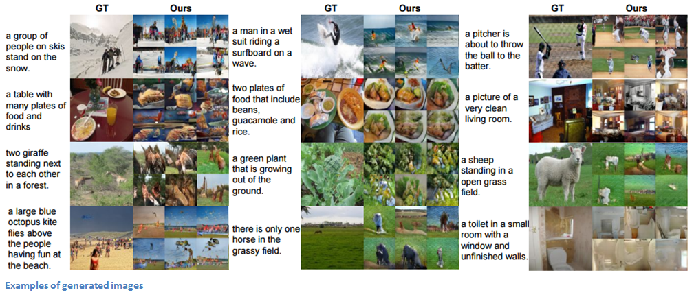
P9
Using GANs to transform text to image
Notes:
this research in 2016 showed a satisfactory results as we can see.
the last progress I’m going to talk about is

Slide 11
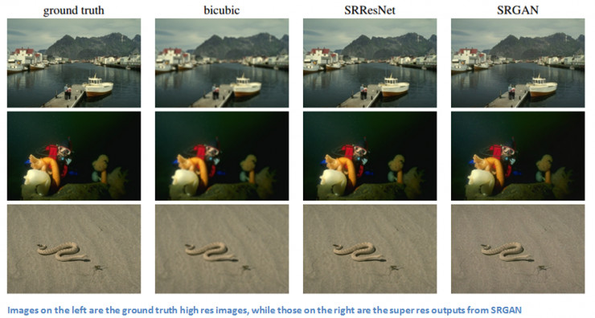
Using GANs to generate super resolution image
P10
Notes:
Using GANs to generate super resolution image
In 2016, a research team of twitter offered a brand new loss function of GANs that enables the network to recover realistic textures and grained details from images that have been heavily damages.
This loss function can be divided into two parts, the adversarial loss and the content loss. the adversarial loss encourages images that look more natural and the content loss makes sure that the new image has similar features to the original low res image.
In a word, this makes sure that the final image can be more natural in the process of increasing resolution without losing original features. It can also be thought that it focus more on natural image instead of the precision of original pixels.
GAN is a new method as well as the adversarial training which is awarded as the coolest thing since sliced bread. It still has to overcome many obstructs to achieve the ideal process that two network can be improved in same pace, but it truly opens another door for the training of AI.

Slide 12
THANK YOU FOR LISTENING
Notes:
That’s all thank you

